Slide 1
G3 File Processing For CCAT Quick-Look Map-Making
Jonah Lee

Slide 2
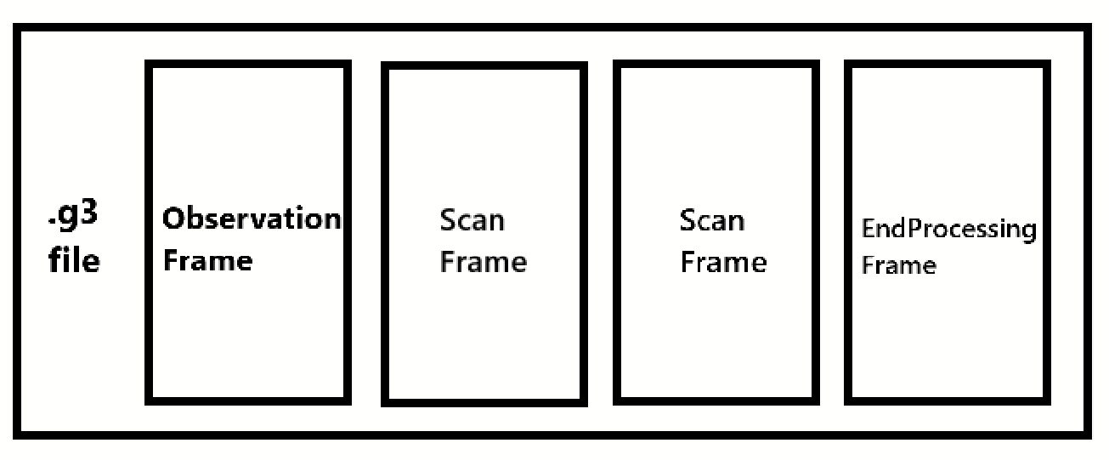
Overview
.g3 files represent an ordered collection of serialized G3Frames
To process a .g3 file:
Create a pipeline by stringing together modules
Modules are functions (or callable objects) which act on frames
The first module is responsible for generating frames. This could be a G3Reader, for example
Run the pipeline!
G3Frames:
behave like dictionaries which map strings → G3FrameObjects
can be quickly written to disk at any time using the dill Python module
There are many types of G3FrameObjects, included in various modules
container classes for basic types: G3Int, G3String, G3VectorDouble, etc.
application-specific classes: G3TimestreamMap, FlatSkyMap
Simons’ so3g package introduces its own G3FrameObjects - we could potentially make our own as well

Slide 3
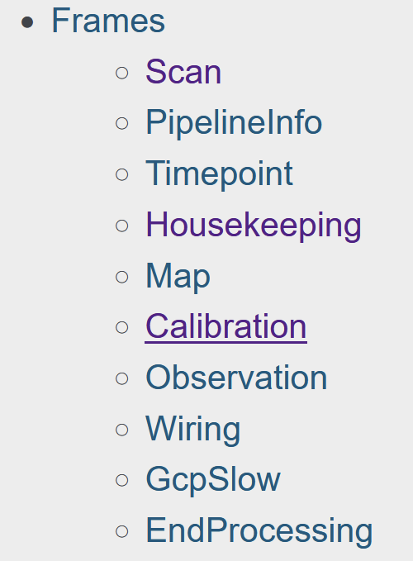
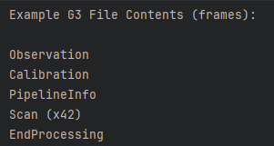
Types of G3Frames
https://cmb-s4.github.io/spt3g_software/frames.html
“The basic unit of data processing is the frame. Each frame is a free-form mapping from strings to data of a type derived from G3FrameObject. In general, they behave as Python dictionaries. Wrappers are provided for Python plain-old-data types (numbers, strings, etc.) so that they can be used directly.”
Scan frames are the most common unit of data for analysis. They contain the data from a single left-to-right (or right-to-left) scan of the telescope. Where quantities are bolometer-indexed, the names match those in the Wiring map.

Slide 4
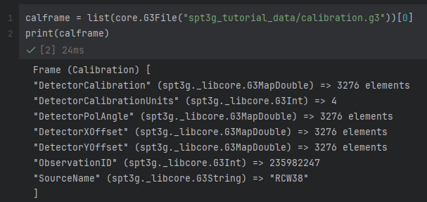
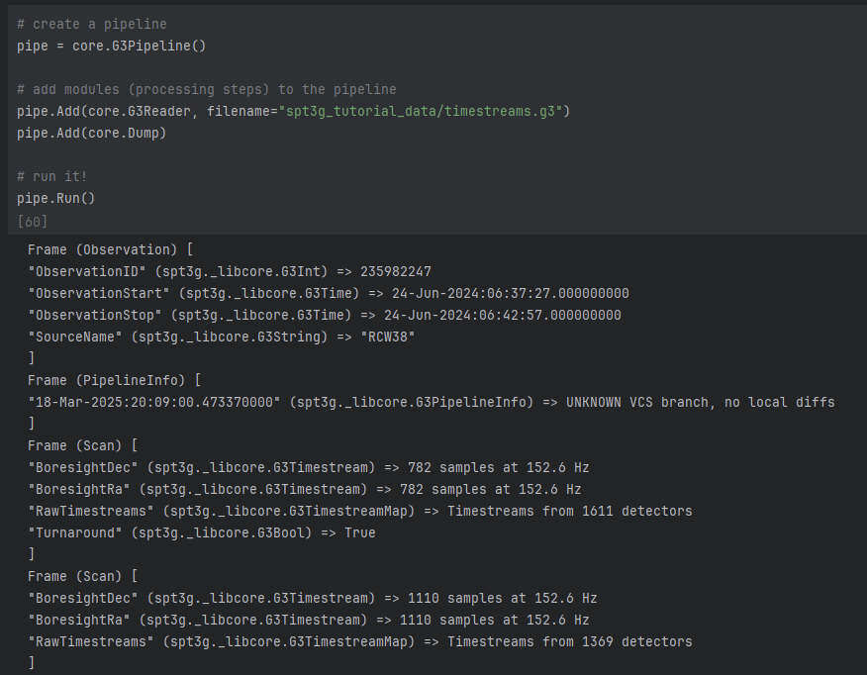
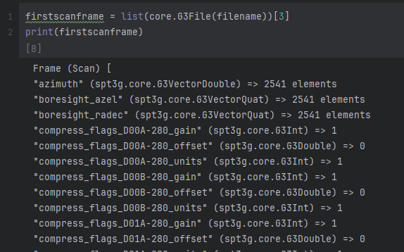
Some Frame Examples
Sources: Sourav & https://github.com/arahlin/spt3g_tutorials

Slide 5
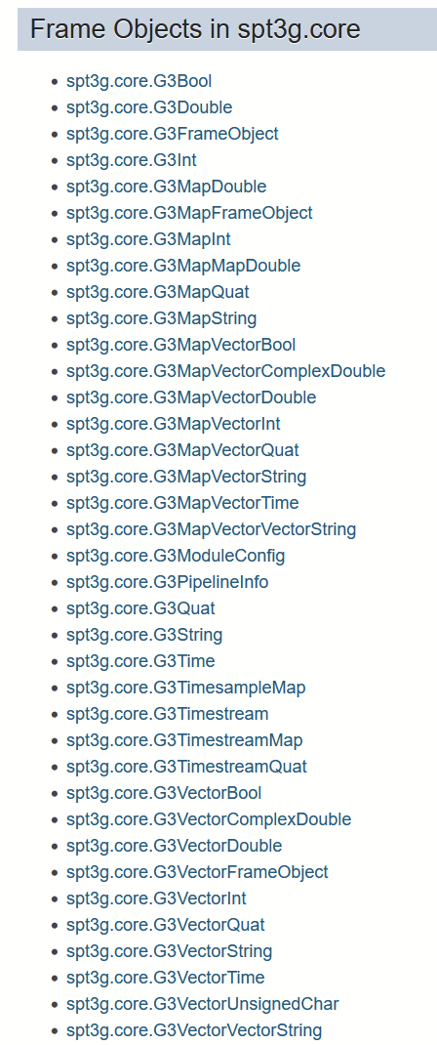
G3FrameObject Data Types in spt3g.core
https://cmb-s4.github.io/spt3g_software/moddoc_core.html
Basic Containers: int, bool, double, string, UTC Time, etc.
Various Vector/Map types for above
G3TimesampleMap: Mapping from string to vectors of data, with an associated vector of timestamps. This object is for storing multiple co-sampled vectors with a single set of (irregular) timestamps.
G3Timestream: Detector timestream. Includes a units field and start and stop times. Can otherwise be treated as a numpy array with a float64 dtype. Conversions to and from such arrays (e.g. with numpy.asarray) are fast. Note that a numpy array constructed from a timestream will share a memory buffer: changes to the array affect the timestream and vice versa. Most binary timestream arithmetic operations (+, -) check that the units and start/stop times are congruent.

Slide 6
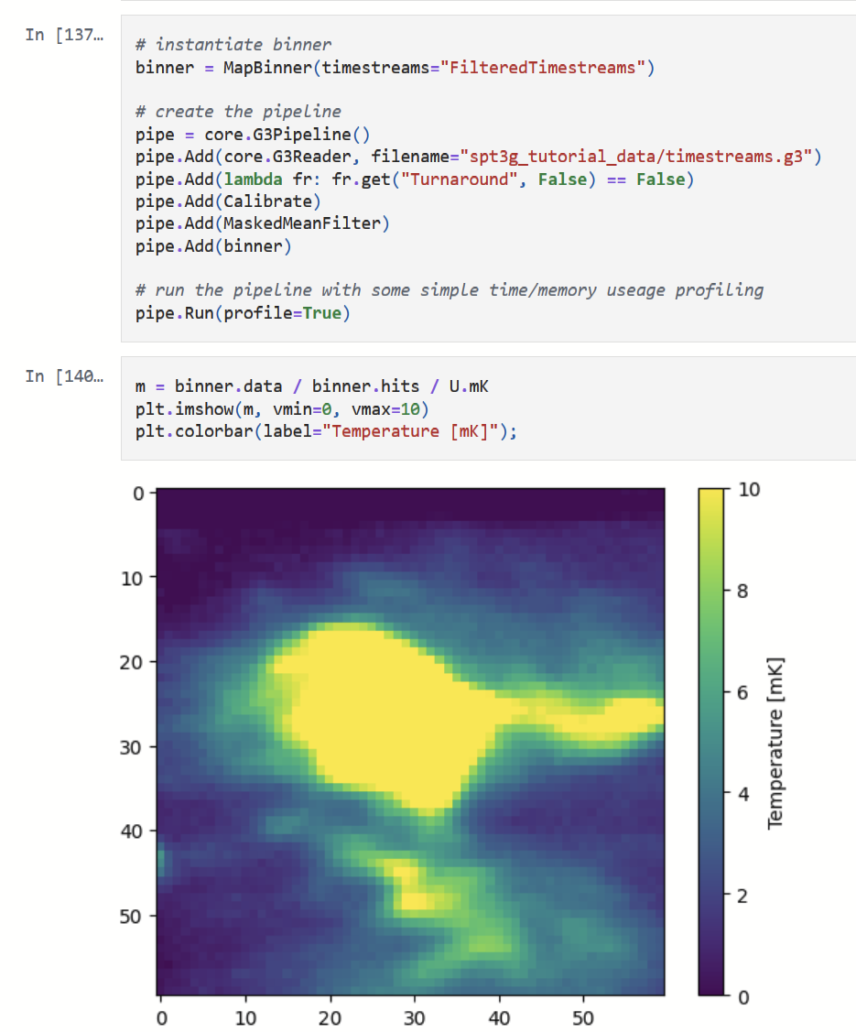
spt3g_tutorials
https://github.com/arahlin/spt3g_tutorials
https://github.com/jonahjlee/spt3g_tutorials/blob/main/filter_and_bin_mapmaking.ipynb
This Jupyter notebook introduces the g3 file format and walks the user through the process of creating a simple filter+bin map maker.
It also links to some sample g3 files to analyze.
https://sptlocal.grid.uchicago.edu/~arahlin/cmb_school_2024/

Slide 7
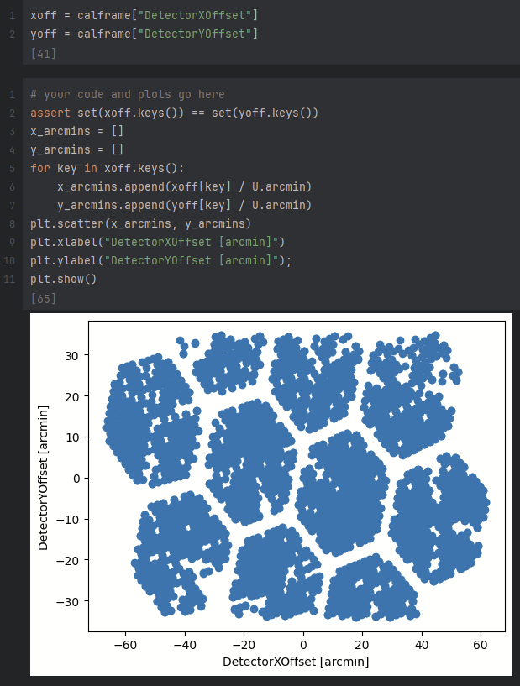
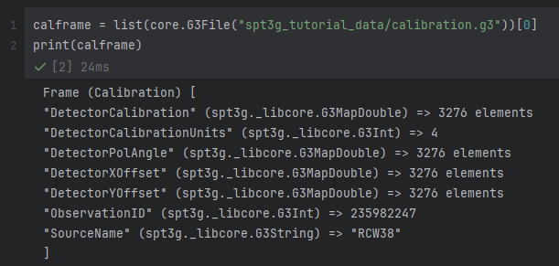
spt3g_tutorials --- Step 1: Preview Data
While data processing typically happens in a pipeline, it is possible to load files directly for quick analysis

Slide 8
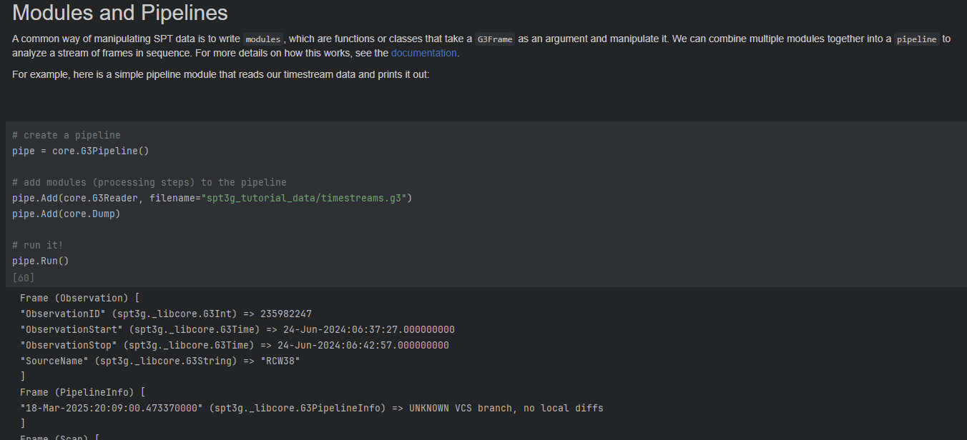
spt3g_tutorials --- Step 2: Running a Pipeline

Slide 9
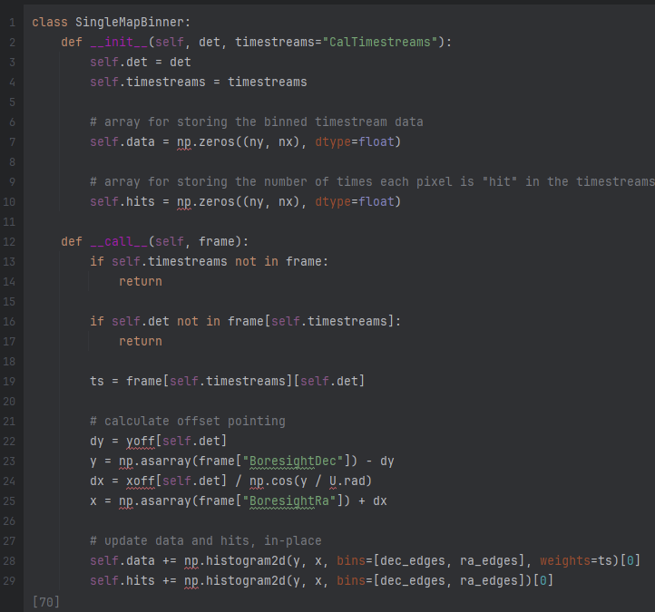
spt3g_tutorials --- Step 3: Making a Module
https://cmb-s4.github.io/spt3g_software/modules.html#writing-a-module-in-python
There are several ways to write modules in Python:
as functions which take a frame as the first positional argument & any number of kwargs
as callable objects (e.g. SingleMapBinner)
as subclasses of core.G3Module

Slide 10
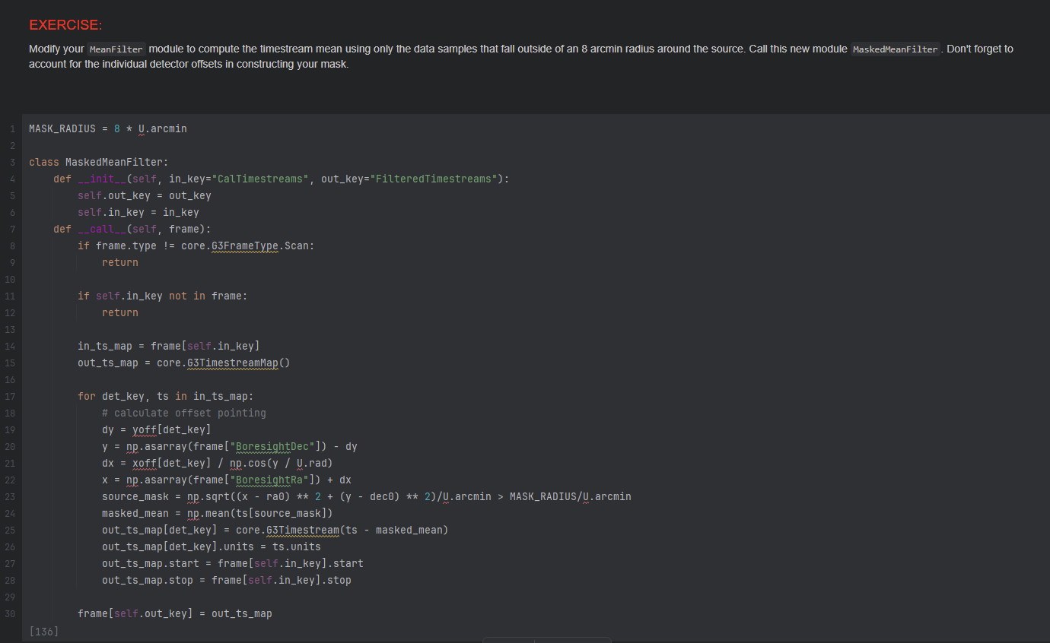
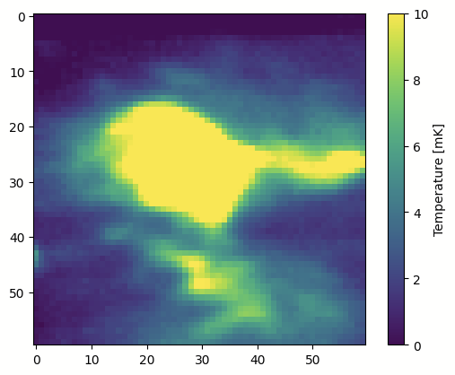
spt3g_tutorials --- Step 4: More Advanced Modules

Slide 11

sotodlib SMURF integration? No…
I was excited to find some software called “G3tSMuRF” https://sotodlib.readthedocs.io/en/latest/g3tsmurf.html#.
The lowercase “u” seemed a little suspicious though…
Alas, they are referring to “SLAC Microresonator Radio Frequency (SMuRF)” and not the “Sub-Millimetre User Reduction Facility”.
Source: smurfs.fandom.com

Slide 12
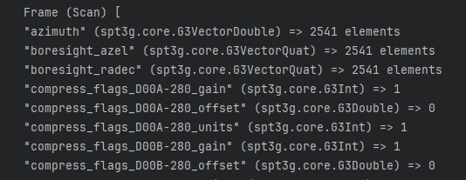
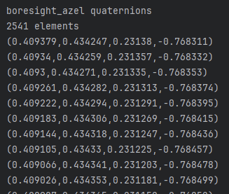
Rotations as Quaternions (G3Quat)
Rotations & directions are sometimes represented as quaternions
Simons’ so3g.proj contains methods for converting between quaternions and other coordinates
spt3g.maps also contains conversion methods between quaternions and other coords
Which should be used when?

Slide 13
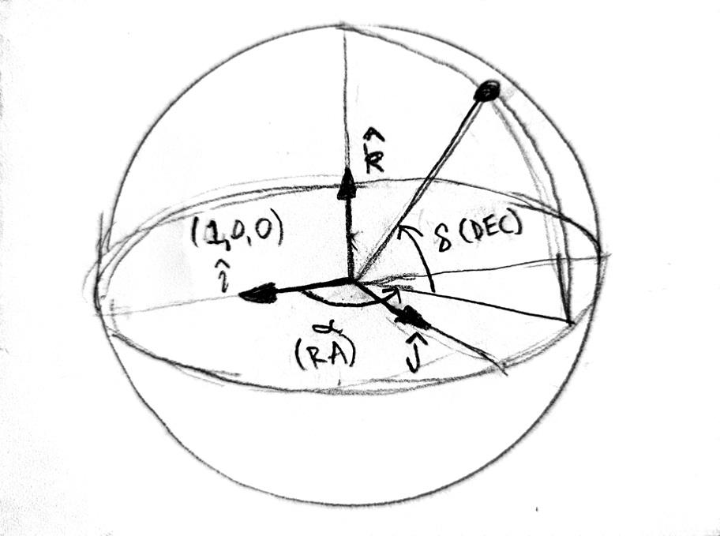
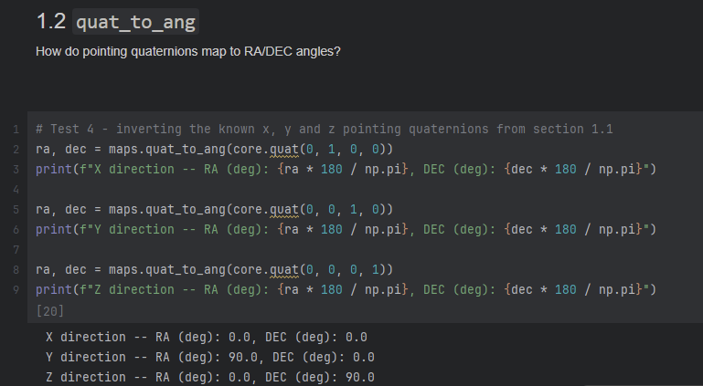
quaternion_tests.ipynb
Experiment with both spt3g & so3g quaternion methods
Work out & verify how quaternions correspond to directions & rotations through testing and experimentation
Links:
https://cmb-s4.github.io/spt3g_software/moddoc_maps.html#map-pointing
https://so3g.readthedocs.io/en/latest/proj.html

Slide 14
Links
https://cmb-s4.github.io/spt3g_software/index.html
https://github.com/ccatobs/rfsoc-streamer
https://so3g.readthedocs.io/en/latest/
https://github.com/arahlin/spt3g_tutorials/blob/main/filter_and_bin_mapmaking.ipynb
Internal SPT docs for private repo: https://southpoletelescope.github.io/spt3g_software/

